Slide 1

Predict Customer Personality to Boost Marketing Campaign
Created by:
Muhammad Chosasih Mahendra
mchosasih@gmail.com
linkedin.com/in/mchosasih/
Click here to visit my portfolio.

Slide 2
Project Description
Personality-based marketing is a strategy that has gained popularity in recent years and is currently shaping the marketing industry. By gaining a deeper understanding of the ways specific personality traits influence purchasing decisions, businesses can design and launch more effective campaigns and establish stronger connections with prospective and current customers (Indeed). In this project, customer personality is analyzed using historical marketing campaign data to improve performance and target consumers that are right for the company. The focus of this project is to make consumer clustering.

Slide 3
Conversion Rate
Outliers
Delete outliers in the Income column where Income is more than 150,000,000. The total deleted outliers are 8.
Null and Odd Value
Fill null value in the Income column with median. Replace Year Birth 1893, 1899, and 1900 with mean.
Extract Columns
Extract new columns; conversion_rate, age, kids, total_transactions, group_age, total_purchases
Grouping Age
Grouping age into five different class;
25 – 34
35 – 44
45 – 54
55 – 64
65+
To see IPYNB file click here

Slide 4
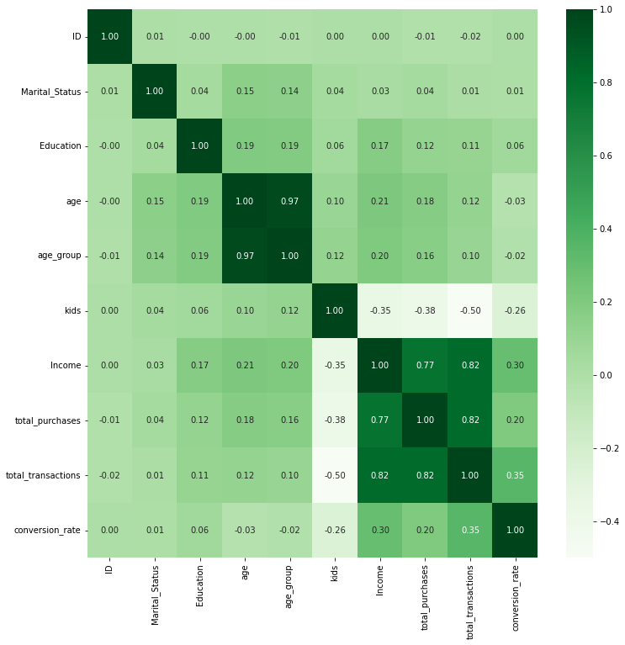

Conversion Rate
Conversion Rate is calculated with Response divided by Number of Web Visit.
The selected features are features that have been extracted and some features that are representative of consumer demographics. Income, kids, total purchases, and total transactions have a direct correlation to conversion rates.
To see IPYNB file click here

Slide 5
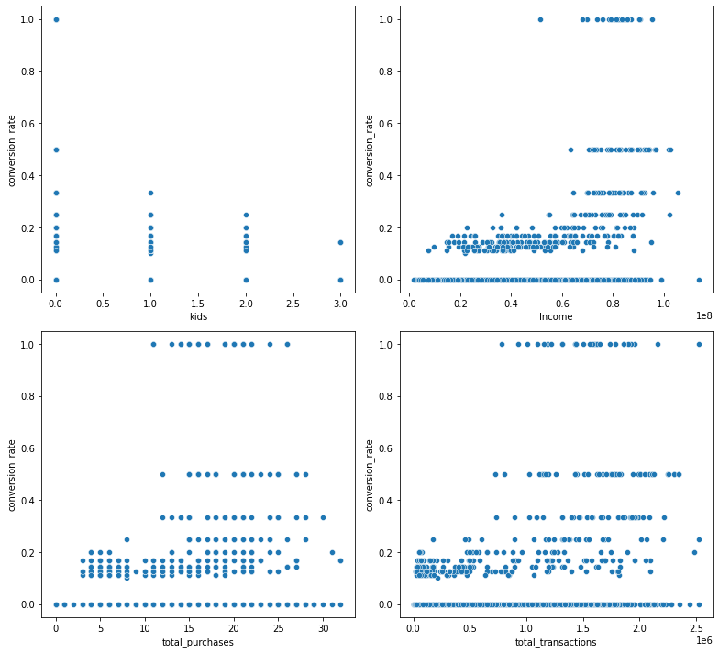
Conversion Rate
The fewer the number of kids, the greater the variation in the conversion rate. And consumers with 3 children have low conversion rates.
Consumers who make less than 10 and more than 30 purchases have a low conversion rate.
Consumers with incomes less than 60,000,000 and more than 100,000,000 have a low potential conversion rate (conversion rate < 0.3)
Consumers with less than 700,000 total transactions only had the highest conversion rate of 0.25.
To see IPYNB file click here

Slide 6

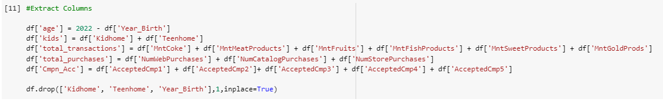
Data Cleaning & Pre-processing
Drop Unnecessary Columns
'Unnamed: 0' is removed because it is the index.
'ID' is removed because it is a unique value for consumers.
'Z_CostContact' and 'Z_Revenue' are removed because they only have 1 unique value.
Extract Columns
New Columns : Age, Kids, Total Transactions, Total Purchases, Total Campaign Accepted.
To see IPYNB file click here

Slide 7

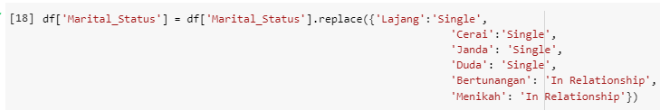


Data Cleaning & Pre-processing
Extract Membership Column
Extract the customer membership from the Dt_Customer column and divide it into three categories
Modify Marital Status
Change the value to only two categories to reduce complexity.
To see IPYNB file click here

Slide 8
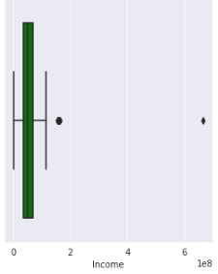
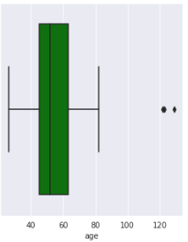
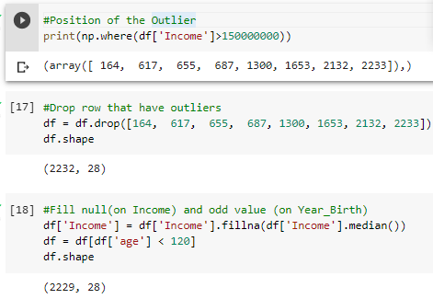
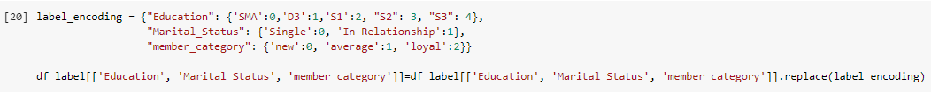
Data Cleaning & Pre-processing
Handle Outliers
Visualize outliers in numeric columns with boxplot. We will handle outliers only in Income and Age columns, because the value seems unusual.
The outliers in the Age column are manipulated. While outliers in the Income column are deleted, and the null value is filled in using the median value.
Feature Encoding
Converting categorical values to numeric.
To see IPYNB file click here

Slide 9
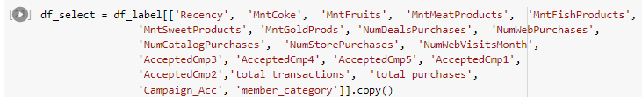
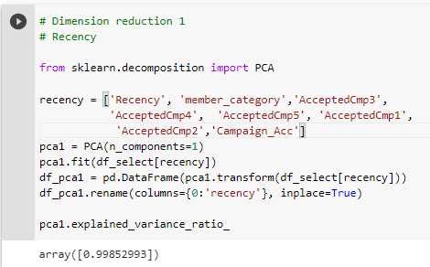
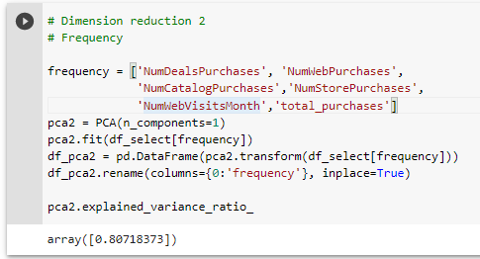
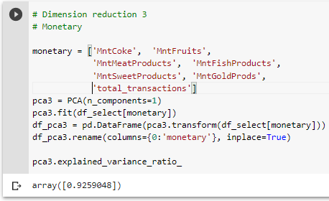
Data Cleaning & Pre-processing
Selecting Features (RFM Analysis)
After the column is selected, then the dimensions are reduced using PCA into 3 dimensions only, namely Recency, Frequency and Monetary.
To see IPYNB file click here

Slide 10

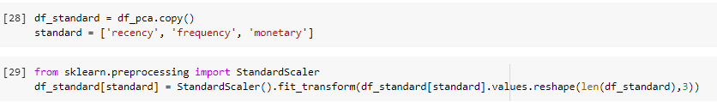
Data Cleaning & Pre-processing
Selecting Features (RFM Analysis)(2)
Join recency, frequency, and monetary column into new dataframe.
Standardization
Standardize numeric value data using StandardScaler.
To see IPYNB file click here

Slide 11
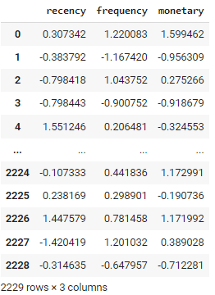
Data Cleaning & Pre-processing
Final Dataframe
Final dataframe used for modeling using KMeans.
To see IPYNB file click here

Slide 12
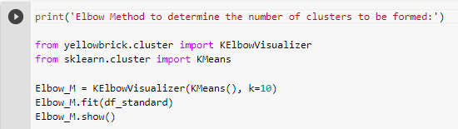
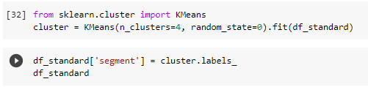
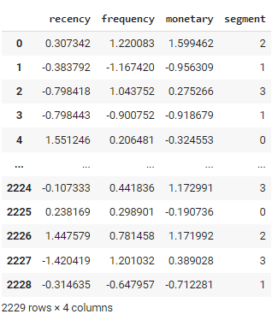
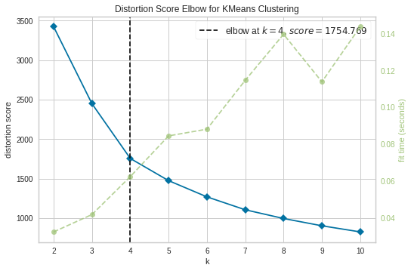
Data Modeling
Elbow Method
Clustering
Using elbow method to find numbers of clusters to make.
Clustering using k means with the number of clusters of 4.
12
To see IPYNB file click here

Slide 13
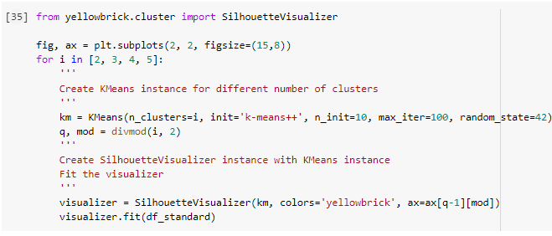
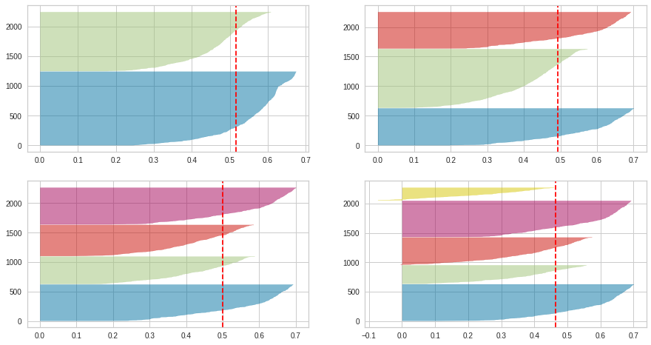
Data Modeling
Silhouette Score
From the silhouette score, the optimum number of clusters is 4. The average coefficient is about 0.5, there is no cluster that has a silhouette score value below the average and the thickness of the four clusters is not too much different. This indicates that the clustering model can distinguish cluster classes from one another.
13
To see IPYNB file click here

Slide 14
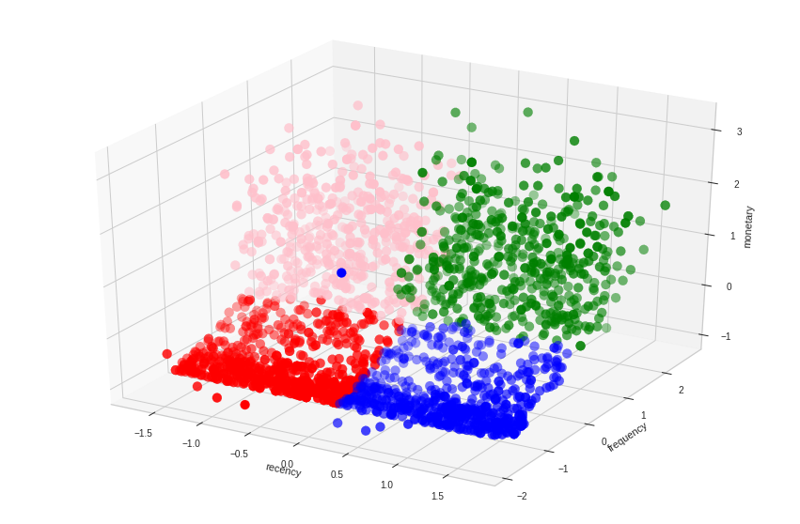
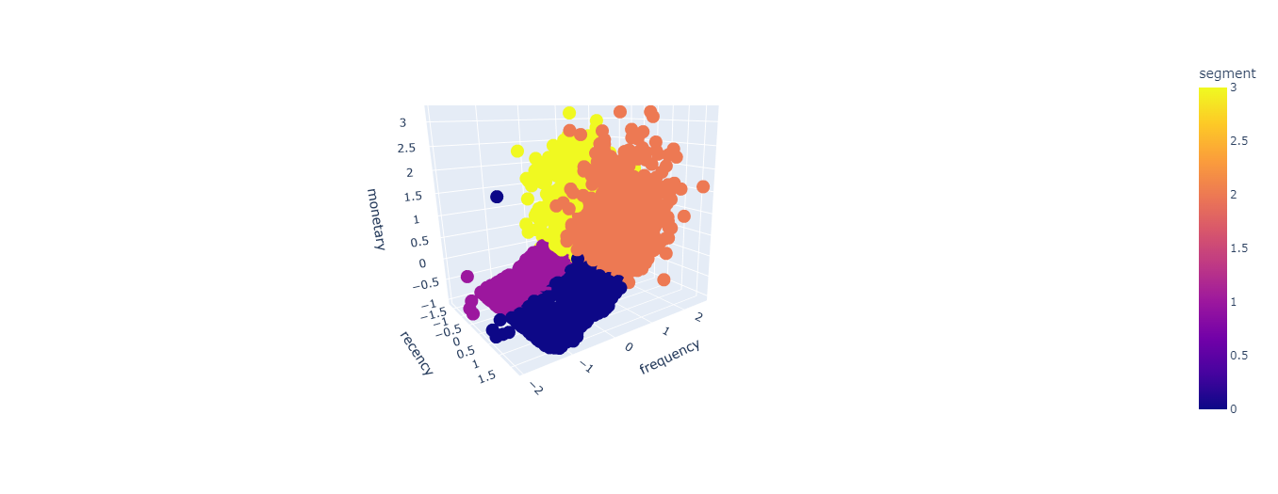
Data Modeling
Visualize Clusters
Static
Interactive
14
To see IPYNB file click here

Slide 15
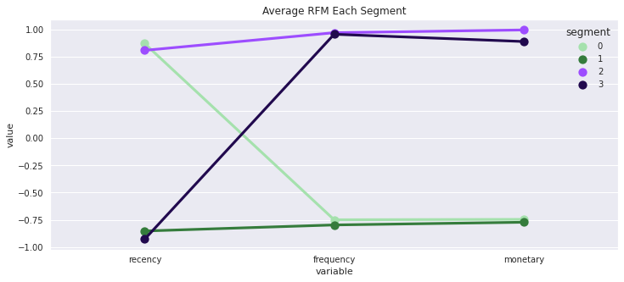
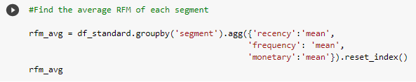
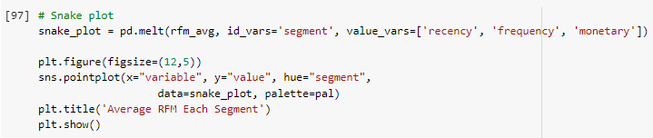
Marketing Retargeting
Average Recency, Frequency, Monetary Each Segments
Segment 0 : Recency high, frequency and monetary low.
Segment 1 : Recency, frequency and monetary low.
Segment 2 : Recency, frequency and monetary high.
Segment 3 : Recency low, frequency and monetary high.
To see IPYNB file click here

Slide 16
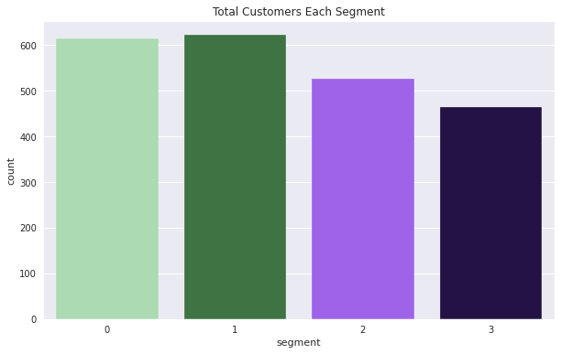
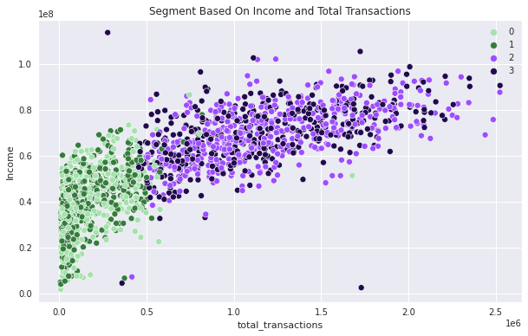
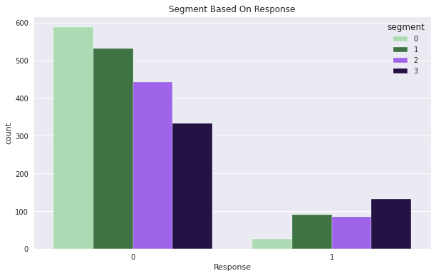
Marketing Retargeting
Demographics
There is no big difference in the number of segments per consumer.
Most of the consumers in the four segments still did not participate at all in the campaign. And only a few consumers in segment 2 and segment 3 always respond to the campaign.
- Segment 0 : Responsiveness to the campaign is very low.
- Segment 1 and Segment 2: Low responsiveness to campaigns.
- Segment 3: Slightly responsive to campaigns.
To see IPYNB file click here

Slide 17
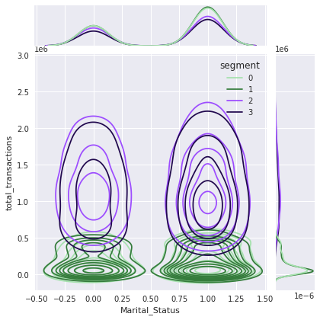
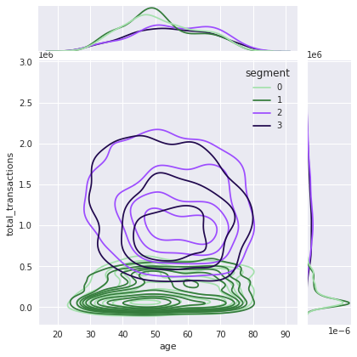
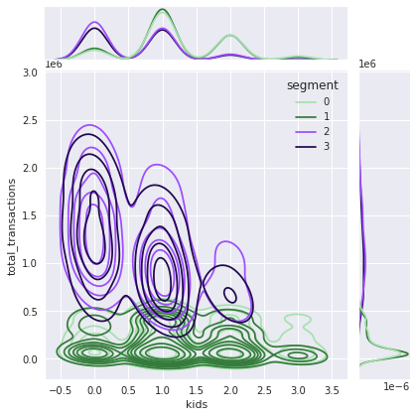
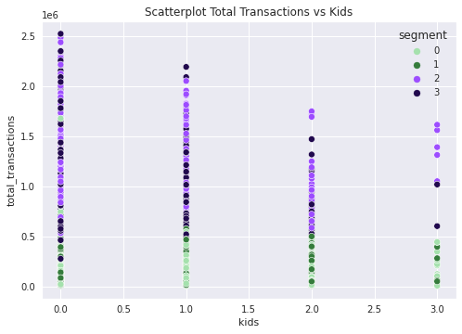
Marketing Retargeting
Demographics
There is no difference between segments in terms of age demographics and marital status.
Segment 2 and Segment 3 have a maximum number of 3. With fewer children, the total transaction tends to increase.
To see IPYNB file click here

Slide 18
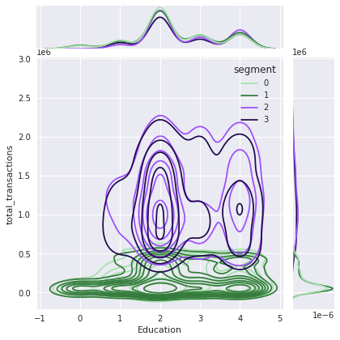
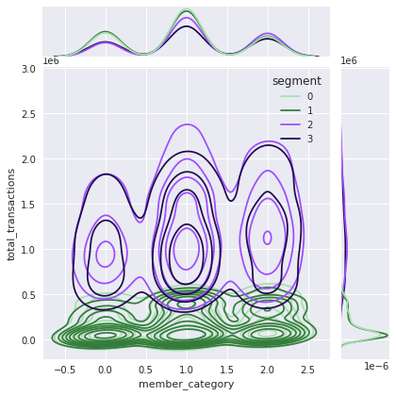
Marketing Retargeting
Demographics
Segment 2 and Segment 3 are not high school graduates.
Segment 2 and Segment 3 are loyal consumers (> 9.4 years per 2022).
To see IPYNB file click here

Slide 19
conclusion
Segment 0
Segment 1
Recency high.
Low to medium income and low total transactions.
Non-responsive to campaigns.
New and Average member category of customers ( < 9.4 years per 2022).
Recency low
Low to medium income and low total transactions
Low responsiveness to campaigns
New and Average member category of customers ( < 9.4 years per 2022)
To see IPYNB file click here
Segment 2
Segment 3
Recency high
Medium to high income and total transactions
Low responsiveness to campaigns
Not SMA (High School) graduates
Maximum number of kids are 2, fewer children total transactions tends to increase.
Loyal member category of customers ( > 9.4 years per 2022)
Recency low
Medium to high income and total transactions
Slightly responsive to campaigns
Not SMA (High School) graduates
Maximum number of kids are 2, fewer children total transactions tends to increase.
Loyal member category of customers ( > 9.4 years per 2022)
19

Slide 20
conclusion
In conclusion, consumers who are suitable to be used as marketing retargeting are consumers who fall into the segment 2 and 3 categories
To see IPYNB file click here

